Slide 1

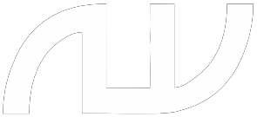
IITK
AUTONOMOUS UNDERWATER VEHICLE
Introductory Session
October 08, 2017
Notes:
Naveen

Slide 2
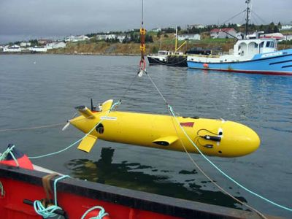
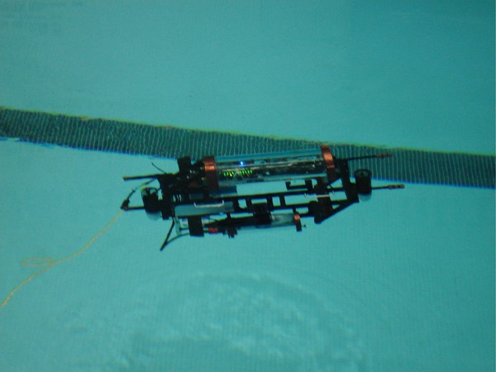
Why AUV?
Unmanned, self propelled vehicles
Operate independently for a period of few hours to several days
Used in oceanographic and data collection in marine environments.

Slide 3

IITK

Slide 4
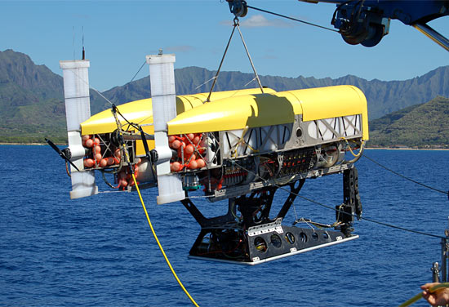
IITK
Deepest AUV: Neerus
Hybrid design with both autonomous and remote controlled capabilities
Reached the Mariana Trench in 1998 with a total of 40 km optic fibre cable.
Max depth of current day submarine is around 750m

Slide 5
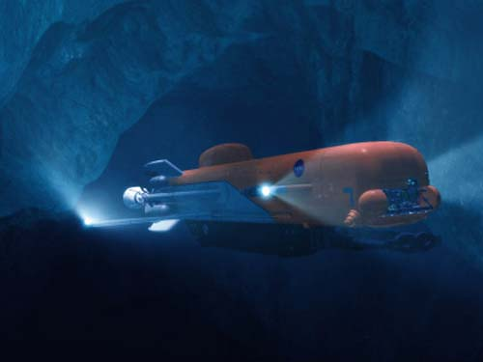
IITK
Future of AUV
Japan creating an AUV with cutting edge technology for mineral exploration and monitoring nuclear reactors
NASA planning to send an AUV to Jupiter’s moon Europa to explore the world beneath its icy surface.

Slide 6
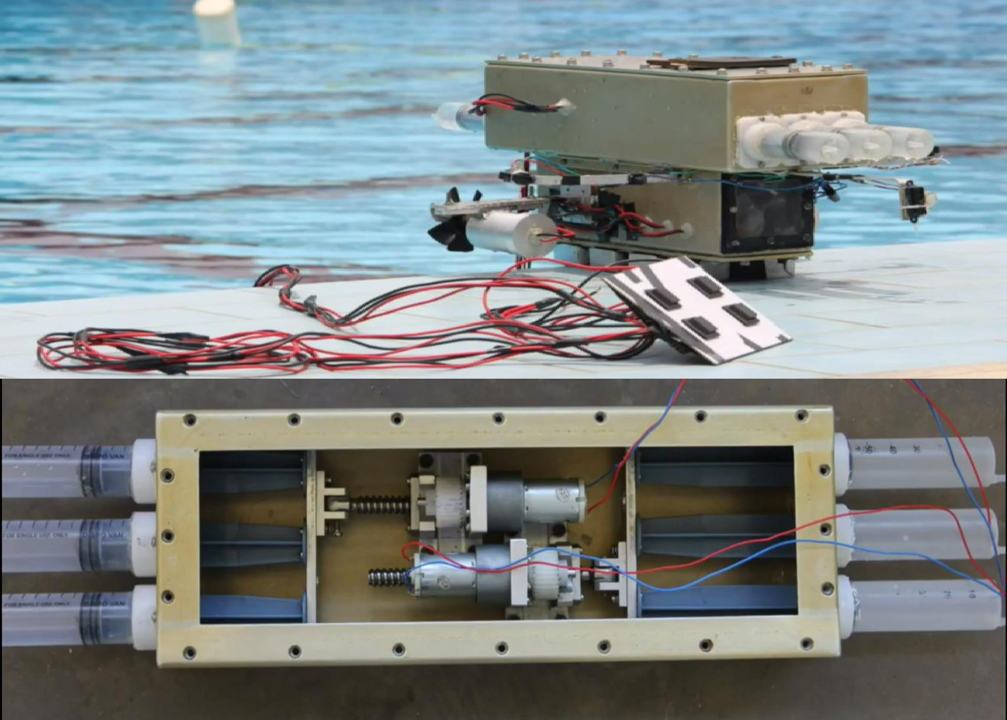
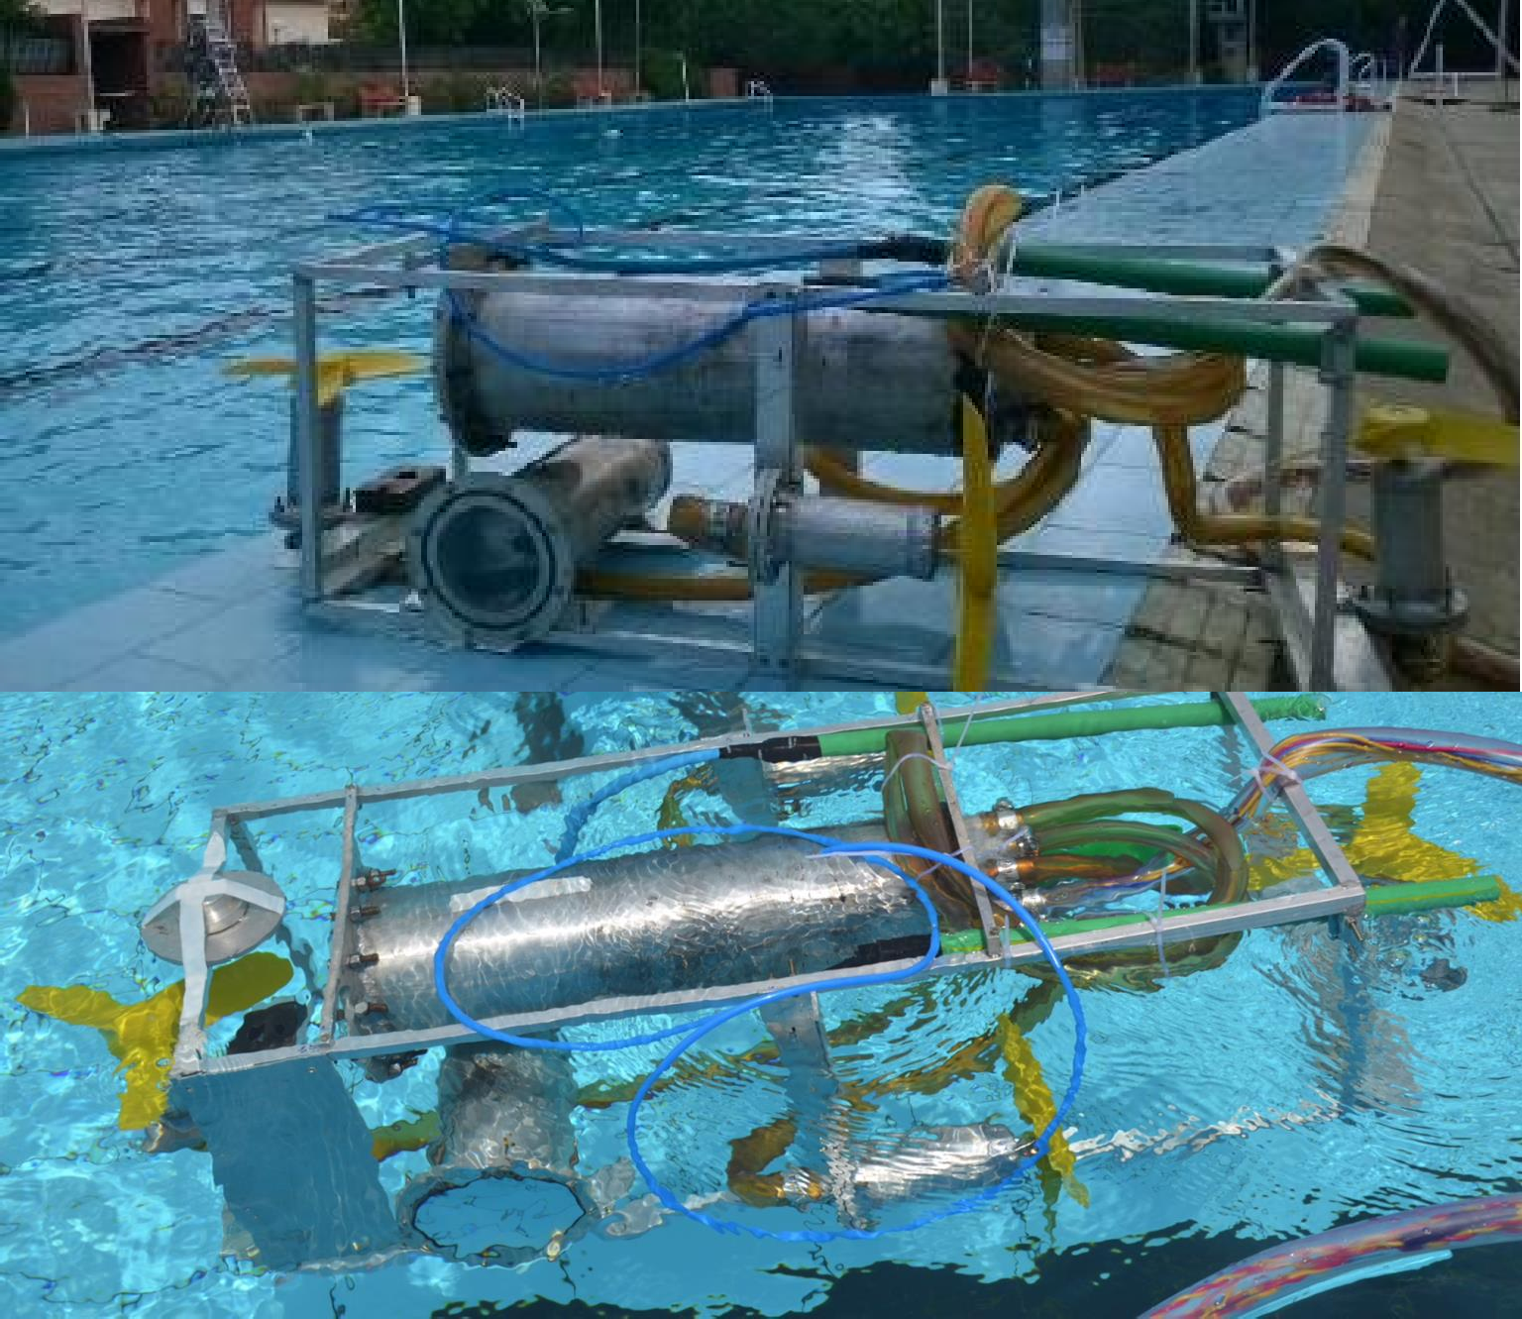
OUR HISTORY
IITK
PROTOTYPE I
PROTOTYPE II

Slide 7
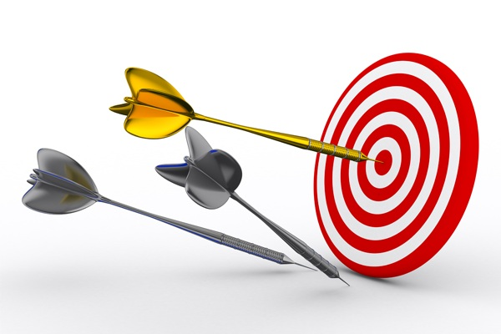
OUR OBJECTIVE
IITK
To promote underwater robotics as an educational interest and future research sector.
To build a robot which can autonomously carry out underwater surveillance, detect, locate and grab objects.
To bring in new ideas and publications on marine technology by providing this platform to people who wish to innovate.
To participate in various National and International competitions.

Slide 8

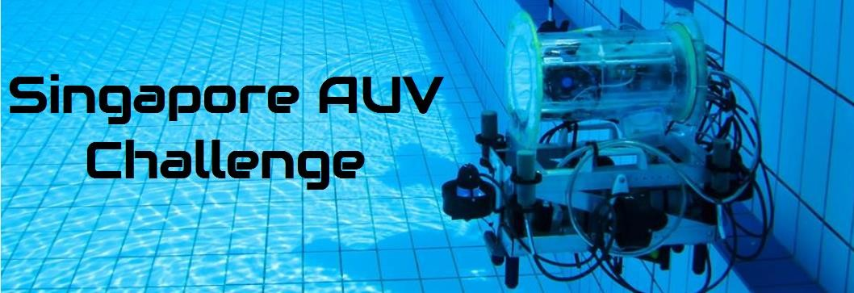

COMPETITIVE EVENTS
IITK
Student Autonomous underwater Vehicle (SAVe)
Organizer: NIOT, Chennai under Ministry of Earth Science Date: October, 2018
Venue: NIOT, Chennai
Singapore AUV Challenge
Organizer: IEEE & OES
Date: March, 2018
Venue: Singapore Polytechnic, Singapore
International RoboSub Competition
Organizer: AUVSI Foundation
(Co-sponsored by U.S. Office of Naval Research) Date: Last week of July, 2018
Venue: SSC Pacific TRANSDEC, San Diego, CA

Slide 9
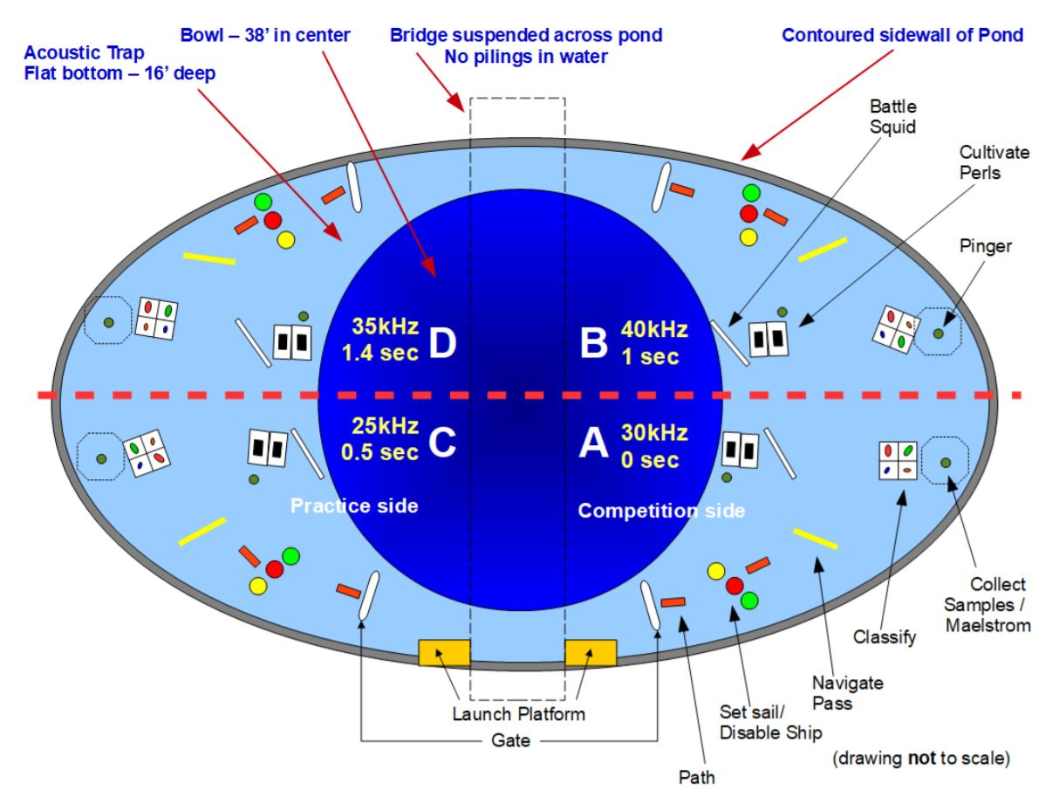

IITK
TASKS IN THE GAME ARENA

Slide 10
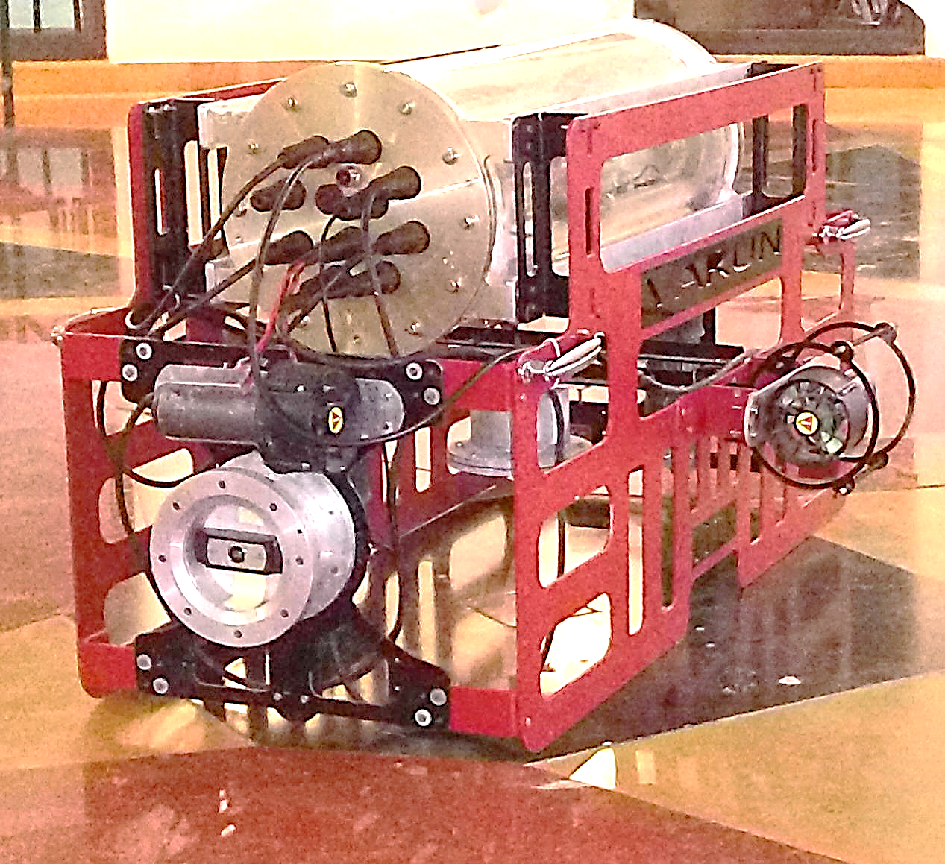
MECHANICAL

Slide 11
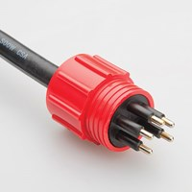
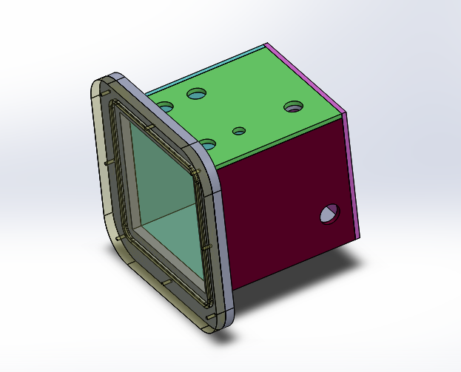
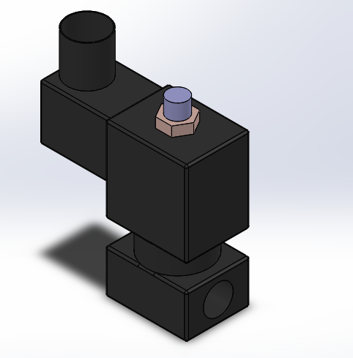
IITK
Mechanical Subsystem
Robot Designing
Design Analysis
Waterproof Casing
Waterproof Connectors
Pneumatic System

Slide 12
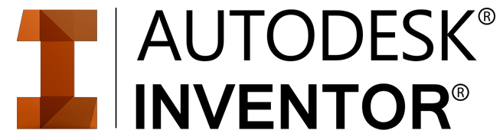

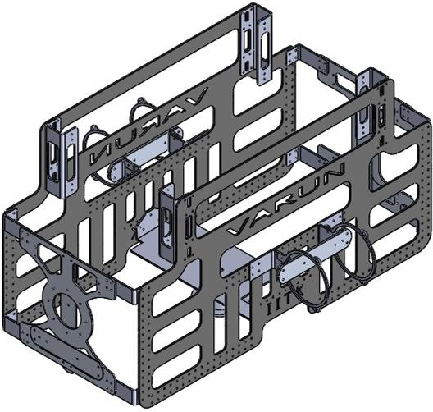
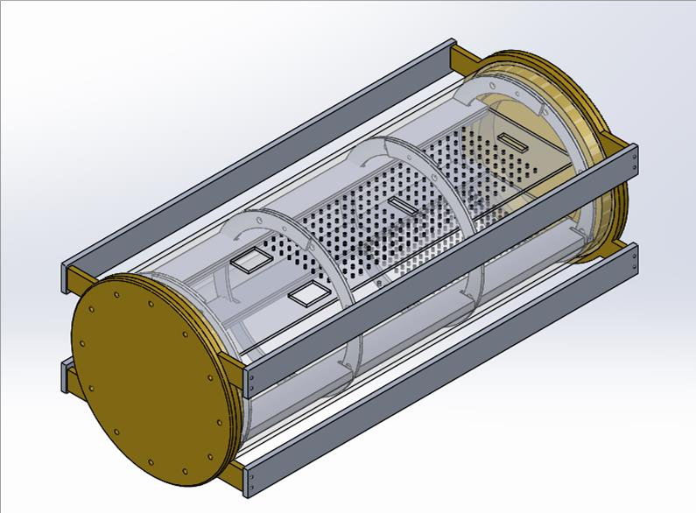
Robot Designing
IITK
Used for designing the robot before fabrication to ensure that everything is picture perfect
3-D view of the robot
Orthographic and isometric views of parts
Selecting the material required

Slide 13
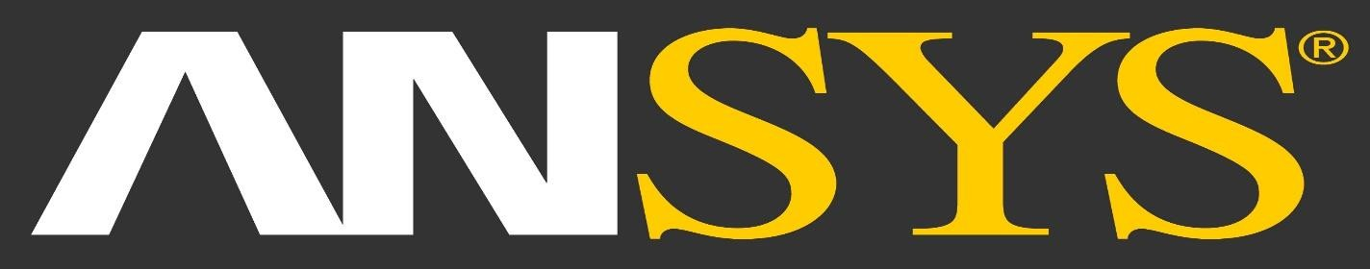
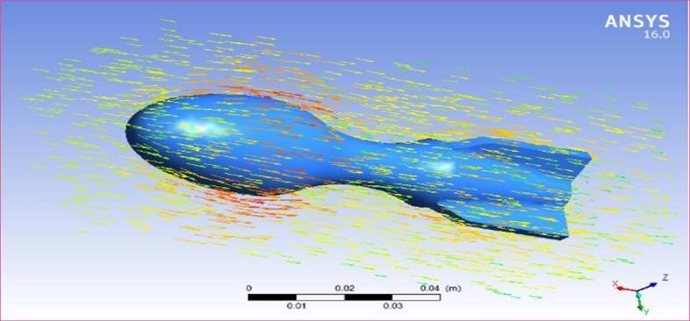
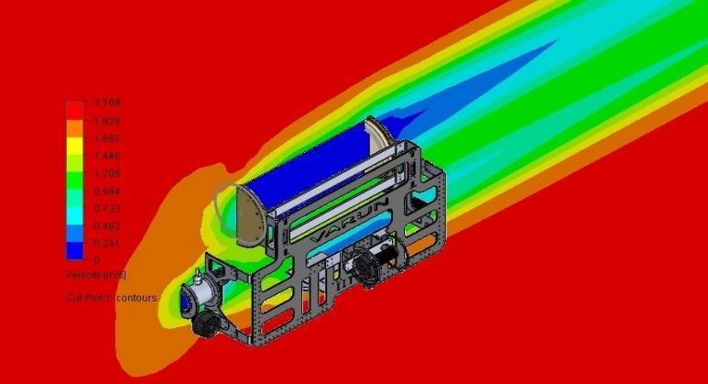
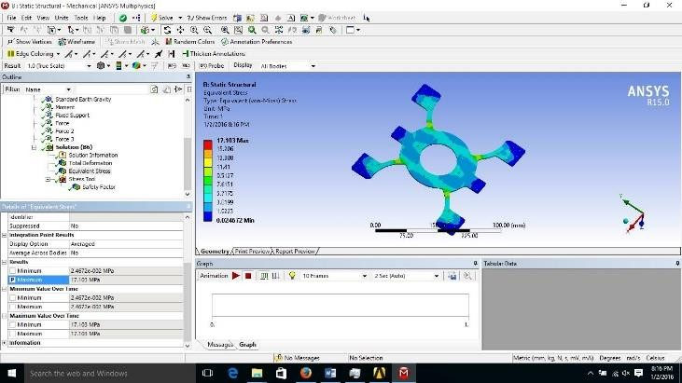
Design Analysis
IITK
Used for analyzing the design for optimizing it’s performance in terms of:
Coefficient of Drag
Centre of Mass
Center of Buoyancy
Vehicle Speed
Weight

Slide 14
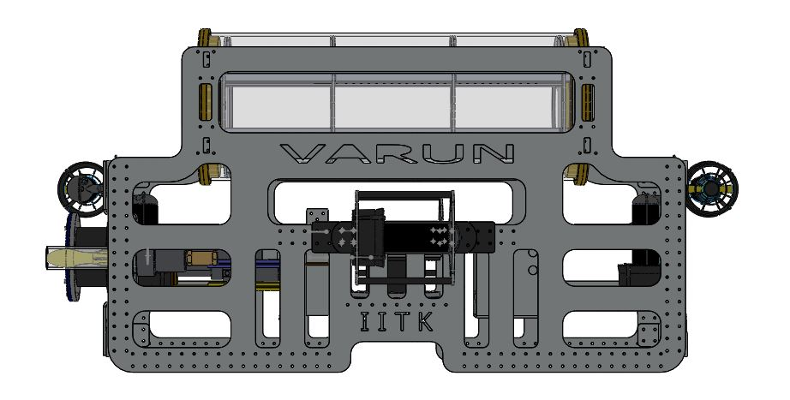
Varun’s Design Specification
IITK
Name: | Varun
Degree of Freedom: | 5
Number of thrusters: | 6
Weight: | 41.550 kg
Buoyancy: | +1%
Dimensions (in mm): | 1430*434*560

Slide 15
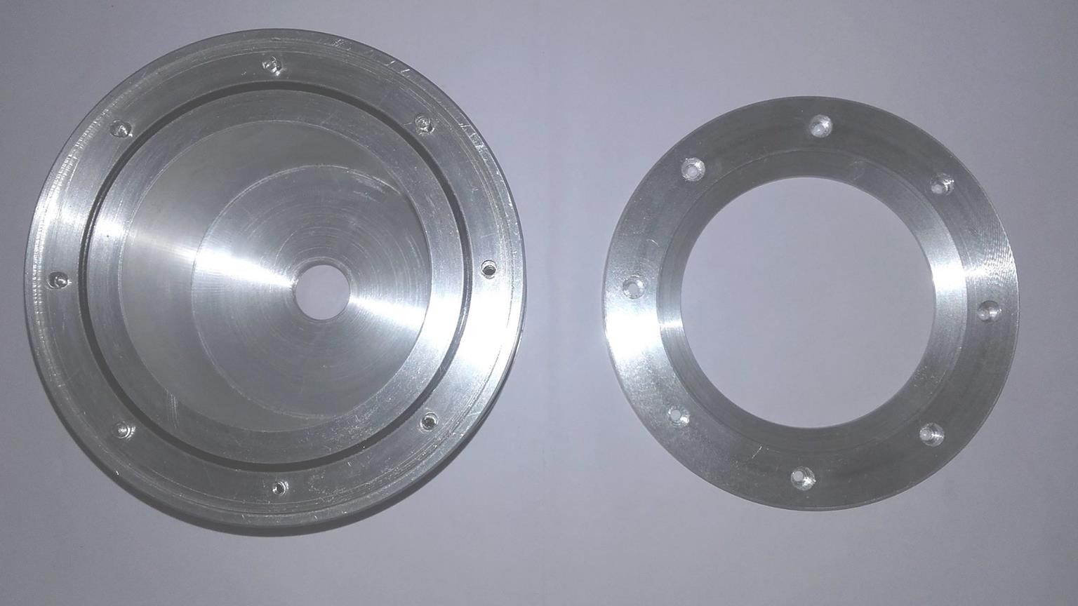
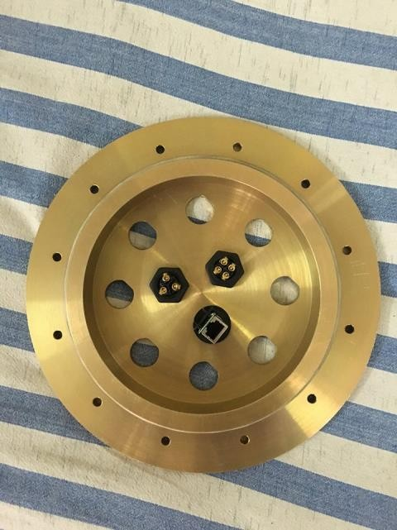
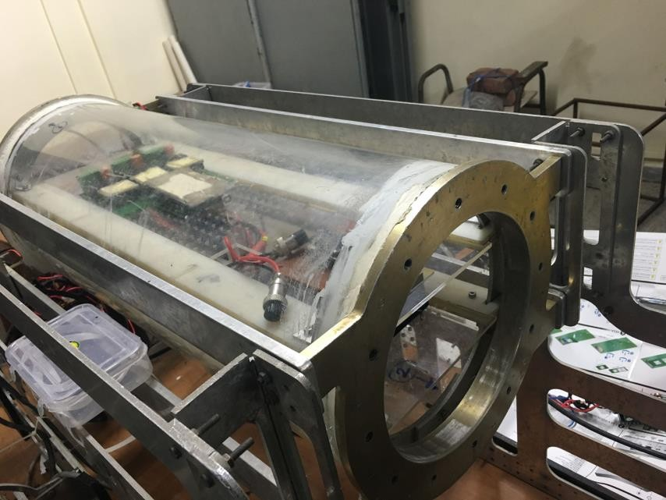
Custom- Made Waterproof Casings
IITK
Manufactured using in-house facilities available at Tinkering Lab and 4-i Laboratory under Mechatronics Lab
Front Camera Casing
Hull Cap with Connectors
Main Pressure Hull

Slide 16
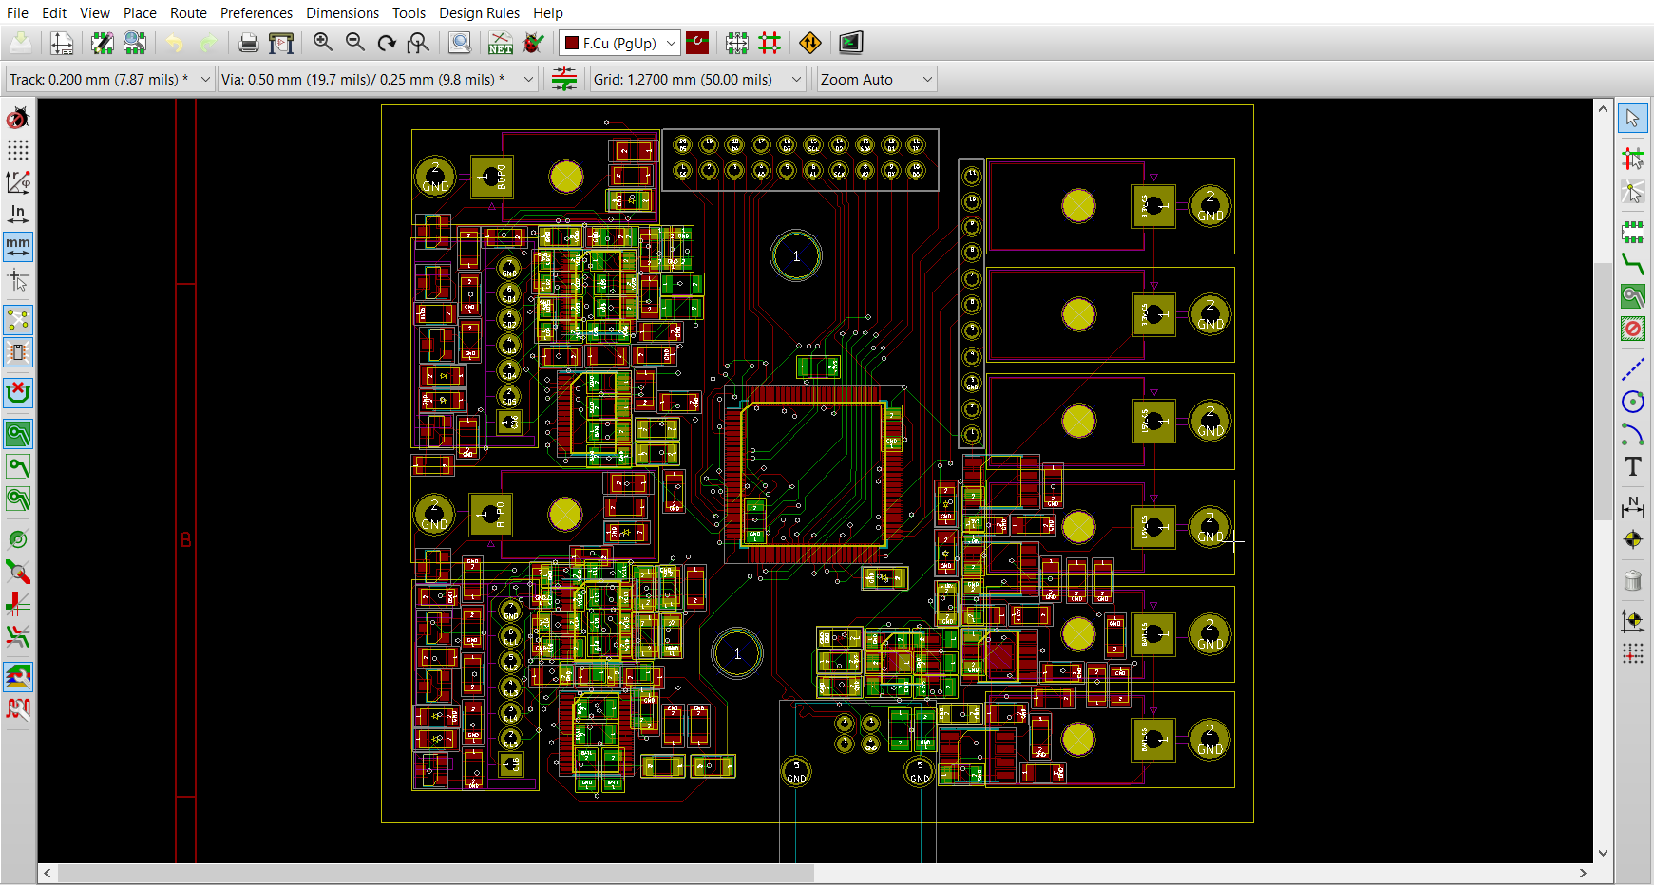
ELECTRICAL

Slide 17
What do we do?
IITK
Battery and power management
Sensors
Actuators
PCB Designing

Slide 18
Battery Management
IITK
LiPo Battery
Pros:
High capacity to weight ratio
Multiple cell configurations available
Rechargeable
High discharge rate
Cons:
Highly sensitive to:
Over charge
Over discharge
Temperature
Relatively expensive

Slide 19
Power Management
IITK
Thrusters 0-12V, Up To 8A
NUC 12-19V, Up To 5A
Arduino, Camera, IMU 5V, Up To 2A
Pressure Sensor 3.3V, Less than 1A

Slide 20
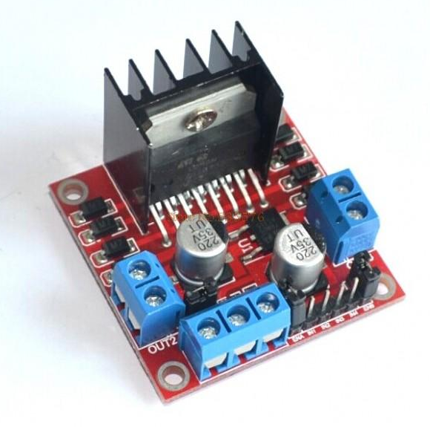
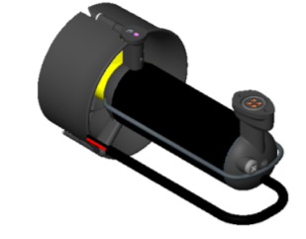
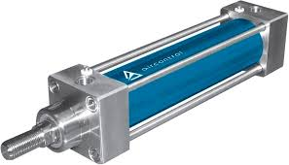
Actuators
IITK
Motor driver
Thrusters
Pneumatics

Slide 21
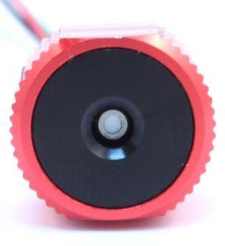
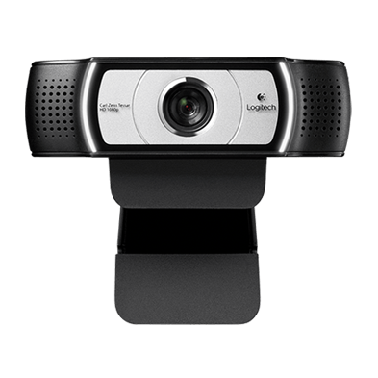
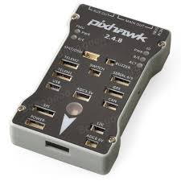
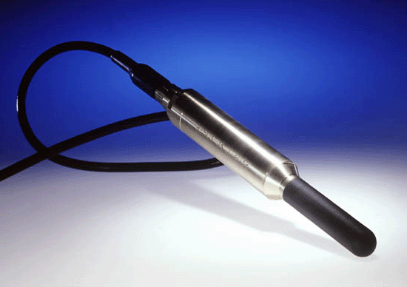
Sensors
IITK
Pressure Sensor
Gives depth of vehicle under the water
Camera
Gives view of arena
IMU
Gives orientation, acceleration
and angular velocities of the bot
Hydrophone
Used for acoustic localization

Slide 22
PCB Designing
IITK
Custom specifications
Compact size
Easy debugging
Easy integration into other systems in the vehicle

Slide 23
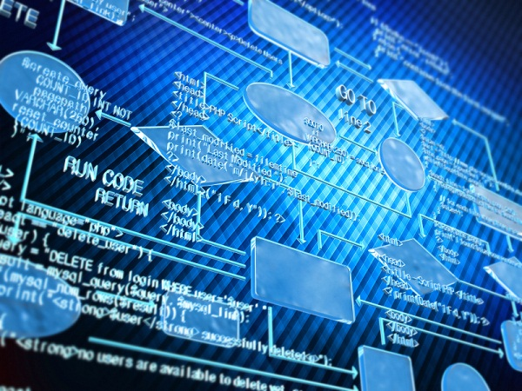
SOFTWARE

Slide 24
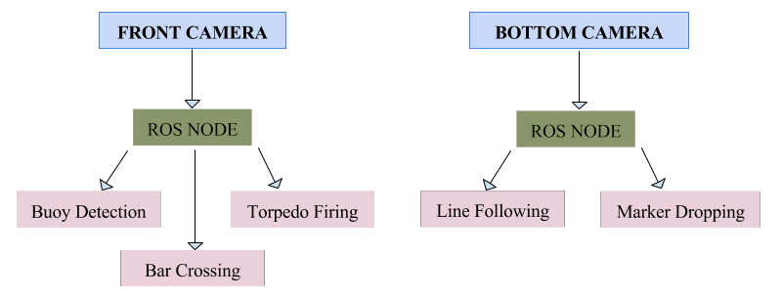
Vision
IITK
LOGITECH C930e

Slide 25
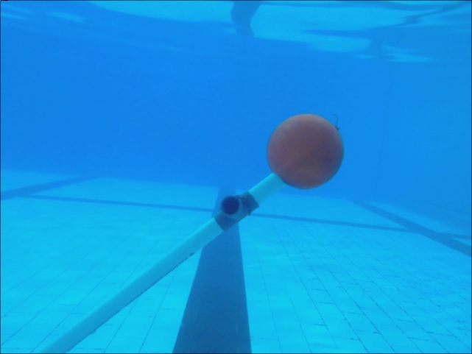

Samples
IITK
Line Detection
Shape Detection
Buoy Detection

Slide 26

ROBOT OPERATING SYSTEM
IITK
Flexible framework for writing robot software
Collection of tools, libraries, and conventions that aim to simplify the task of creating complex and robust robot behavior.
Has built-in messaging system that manages details of communication
between distributed nodes via anonymous publish/subscribe mechanism.
Easier to capture data published by some task (node) to a file, and then republish that data from the file at a later time.

Slide 27

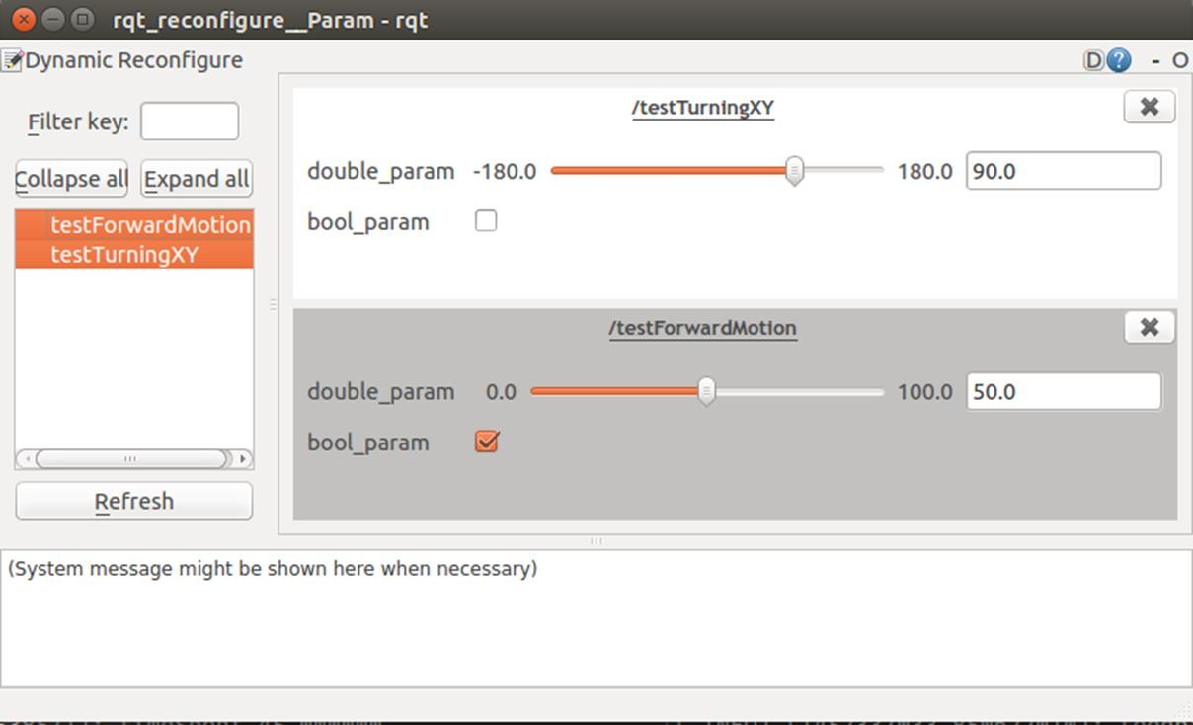
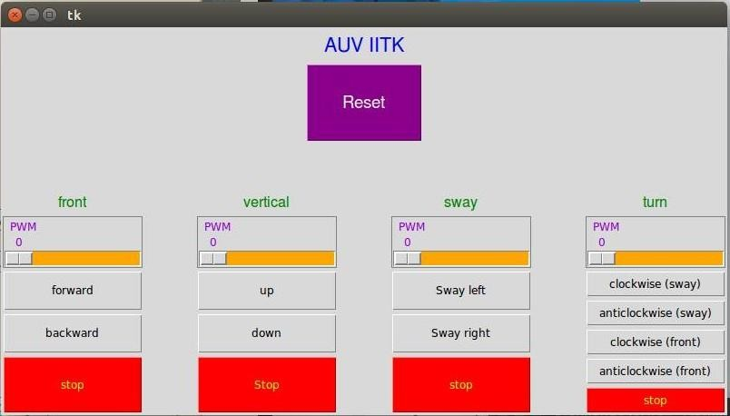
Graphical User Interface(GUI)
IITK
We use this GUI for testing our Bot’s Motion.

Slide 28
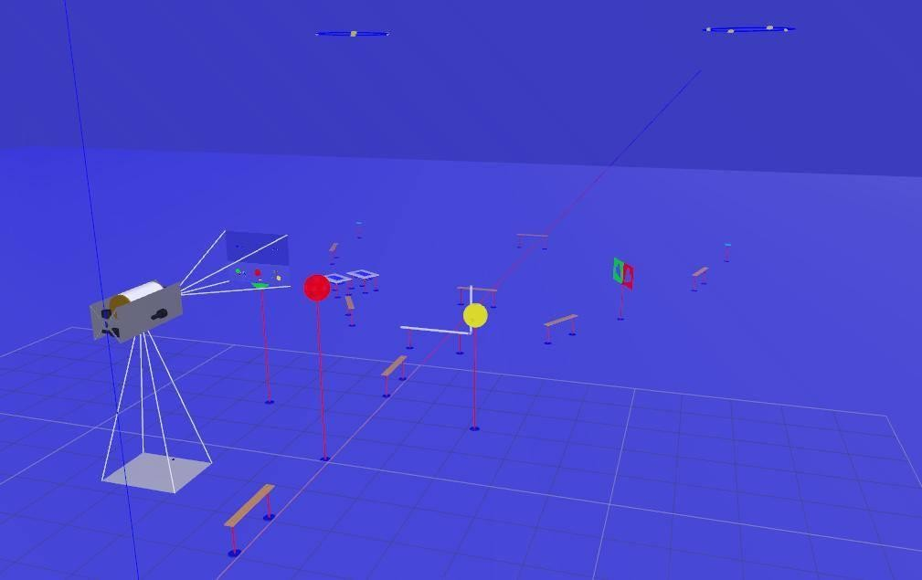

Actually testing our code rather than praying that it'll work!
IITK

Slide 29
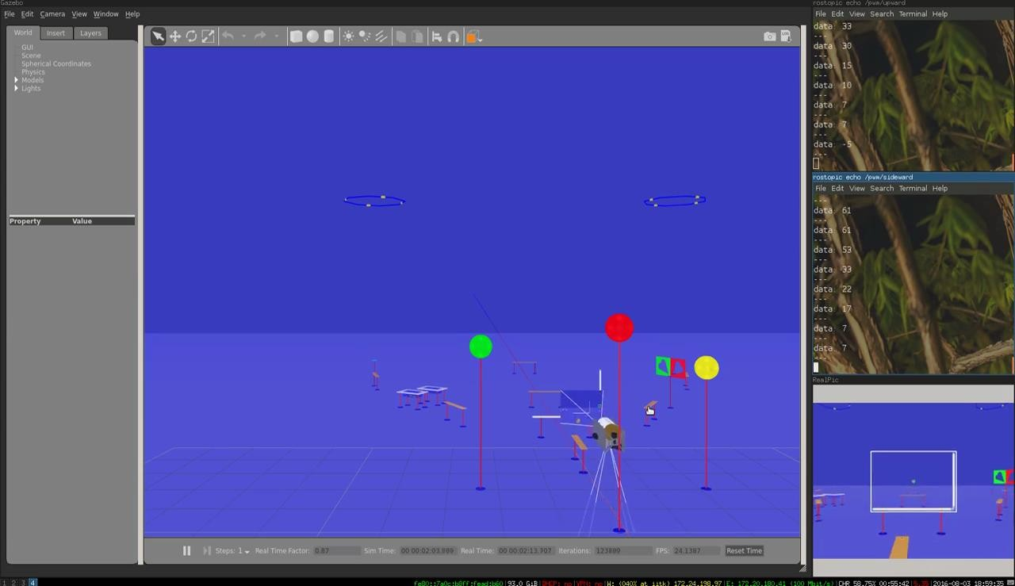
Tasks
IITK
Task_gate
Task_line
line_detection
line_centralize
Line_align
Task_buoy
Task_torpedo
Task_octagon

Slide 30


Slide 31


Face of the Team
IITK
Represent team in various exhibitions and conferences held across the country
Ensures interests of campus community and professors
Opportunity to connect with industrial professionals and experts
Publishes papers and newsletters for the team

Slide 32
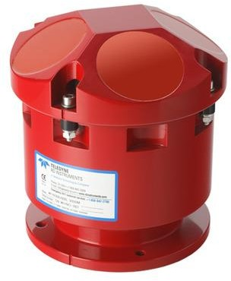

Marketing and Sponsorships
IITK
Establish tie-ups of the team with various companies.
Learn methods of influencing companies and alumni to fund the project.
Learn how to advertise and brand the team.
Sponsorships required to purchase better sensors and have availability of better services to build the robot.
A new sensor we want to purchase called Doppler Velocity Log is worth INR 13 lakhs!
Doppler Velocity Log

Slide 33
Expectations from the Team
IITK
Sub-projects in the groups of 2-3.
Strict deadlines for the work be met.
15-20 hours of work per week.
Have to stay in the winter break during the Winter Camp.
Leaving in-between from the team would lead to no recognition of your work
Above all enthusiasm and dedication for your work and the team

Slide 34
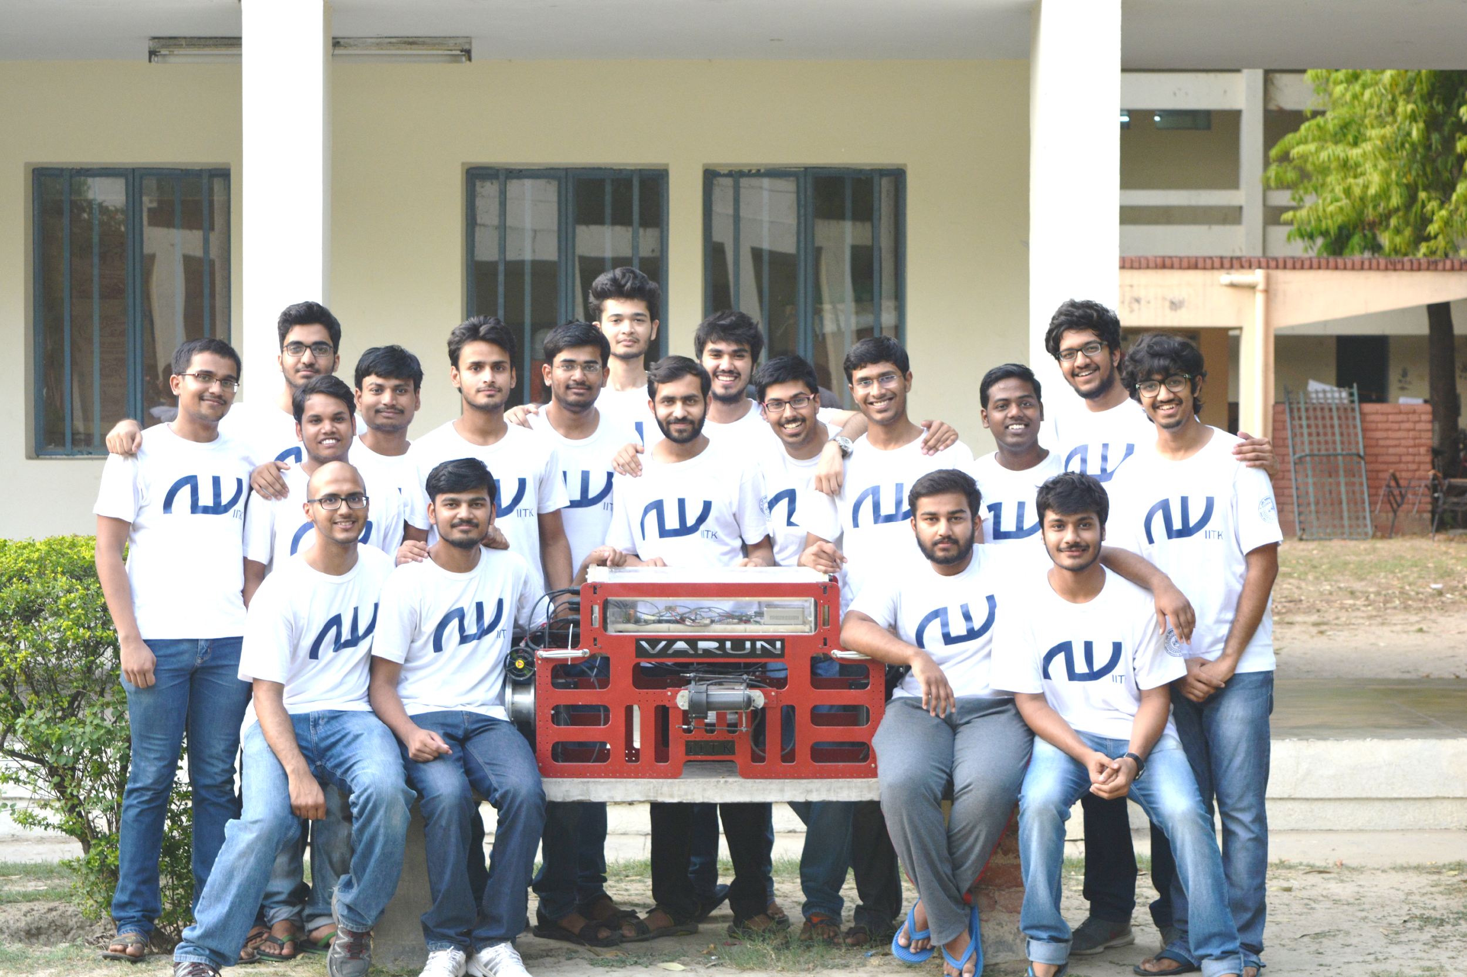
The Team 2016
IITK

Slide 35


Any Questions?
IITK
For more information, visit: auviitk.com, or contact:
Akash Jain 09450533385
Rithvik Patibandla 09133140747
Manish Kumar 09628580293

